Slide 1
Blacktown Chinese Christian Church
Welcome to Our English Service 15.12.2024
English Service 9:45 – 11:00 am
Worship Songs: Passage: Speaker: Topic: Response Song: Announcements and Closing Prayer Benediction
Amazing Grace (My Chains Are Gone) This I Believe Be Thou My Vision T TBA TBA TBA

Slide 2
BCCC english service

Slide 3

Please keep all phones on silent

Slide 4
Amazing Grace (My Chains Are Gone)
Chris Tomlin, John Newton, Louie Giglio ©2006 Rising Springs Music (Admin. by SHOUT! Music Publishing Australia) Vamos Publishing (Admin. by SHOUT! Music Publishing Australia) worshiptogether.com songs (Admin. by SHOUT! Music Publishing Australia) CCLI Licence No. 5485849. CCLI Song number: 4768151

Slide 5
Verse 1
Amazing grace, how sweet the sound
That saved a wretch like me
I once was lost, but now I'm found
Was blind, but now I see

Slide 6
Verse 2
'Twas grace that taught my heart to fear
And grace my fears relieved
How precious did that grace appear
The hour I first believed

Slide 7
Chorus
My chains are gone, I've been set free
My God, my Savior has ransomed me
And like a flood His mercy reigns
Unending love, amazing grace

Slide 8
Verse 3
The Lord has promised good to me
His word my hope secures
He will my shield and portion be
As long as life endures

Slide 9
Chorus 1
My chains are gone, I've been set free
My God, my Savior has ransomed me
And like a flood His mercy reigns
Unending love, amazing grace (x2)

Slide 10
Verse 4
The earth shall soon dissolve like snow
The sun forbear to shine
But God who called me here below
Will be forever mine

Slide 11
Verse 4
Will be forever mine
You are forever mine

Slide 12
This I Believe
Ben Fielding, Matt Crocker © 2014 Hillsong Music Publishing Australia CCLI Licence No. 5485849 . CCLI Song number: 7018338

Slide 13
Verse 1
Our Father everlasting
The all-creating One
God Almighty

Slide 14
Verse 1
Through your Holy Spirit
Conceiving Christ the Son
Jesus our Saviour

Slide 15
Chorus
I believe in God our Father
I believe in Christ the Son
I believe in the Holy Spirit
Our God is three in One

Slide 16
Chorus
I believe in the resurrection
That we will rise again
For I believe in the Name of Jesus

Slide 17
Verse 2
Our Judge and our Defender
Suffered and crucified
Forgiveness is in You

Slide 18
Verse 2
Descended into darkness
You rose in glorious light
Forever seated high

Slide 19
Chorus
I believe in God our Father
I believe in Christ the Son
I believe in the Holy Spirit
Our God is three in One

Slide 20
Chorus
I believe in the resurrection
That we will rise again
For I believe in the Name of Jesus

Slide 21
Bridge 1
I believe in You
I believe You rose again
I believe that Jesus Christ is Lord
(x2)

Slide 22
Chorus 2
I believe in life eternal
I believe in the virgin birth
I believe in the saints' communion
And in Your Holy Church

Slide 23
Chorus 2
I believe in the resurrection
When Jesus comes again
For I believe in the Name of Jesus

Slide 24
Chorus
I believe in God our Father
I believe in Christ the Son
I believe in the Holy Spirit
Our God is three in One

Slide 25
Chorus
I believe in the resurrection
That we will rise again
For I believe in the Name of Jesus

Slide 26
Tag
For I believe in the Name of Jesus
For I believe in the Name of Jesus

Slide 27
Be Thou My Vision
Eleanor Henrietta Hull, Mary Elizabeth Byrne © Words: Public Domain Music: Public Domain CCLI Licence No. 5485849 . CCLI Song number: 30639

Slide 28
Verse 1
Be Thou my Vision, O Lord of my heart
Naught be all else to me, save that Thou art
Thou my best Thought, by day or by night
Waking or sleeping, Thy presence my light

Slide 29
Verse 2
Be Thou my Wisdom, and Thou my true Word
I ever with Thee and Thou with me, Lord
Thou my great Father, I Thy true son
Thou in me dwelling, and I with Thee one

Slide 30
Verse 3
Riches I heed not, nor man's empty praise
Thou mine Inheritance, now and always
Thou and Thou only, put first in my heart
High King of Heaven, my Treasure Thou art

Slide 31
Verse 4
High King of Heaven, my victory won
May I reach Heaven's joys, bright Heaven's Sun!
Heart of my own heart, whatever befall
Still be my Vision, O Ruler of all

Slide 32
Outro
Heart of my own heart, whatever befall
Still be my Vision, O Ruler of all

Slide 33
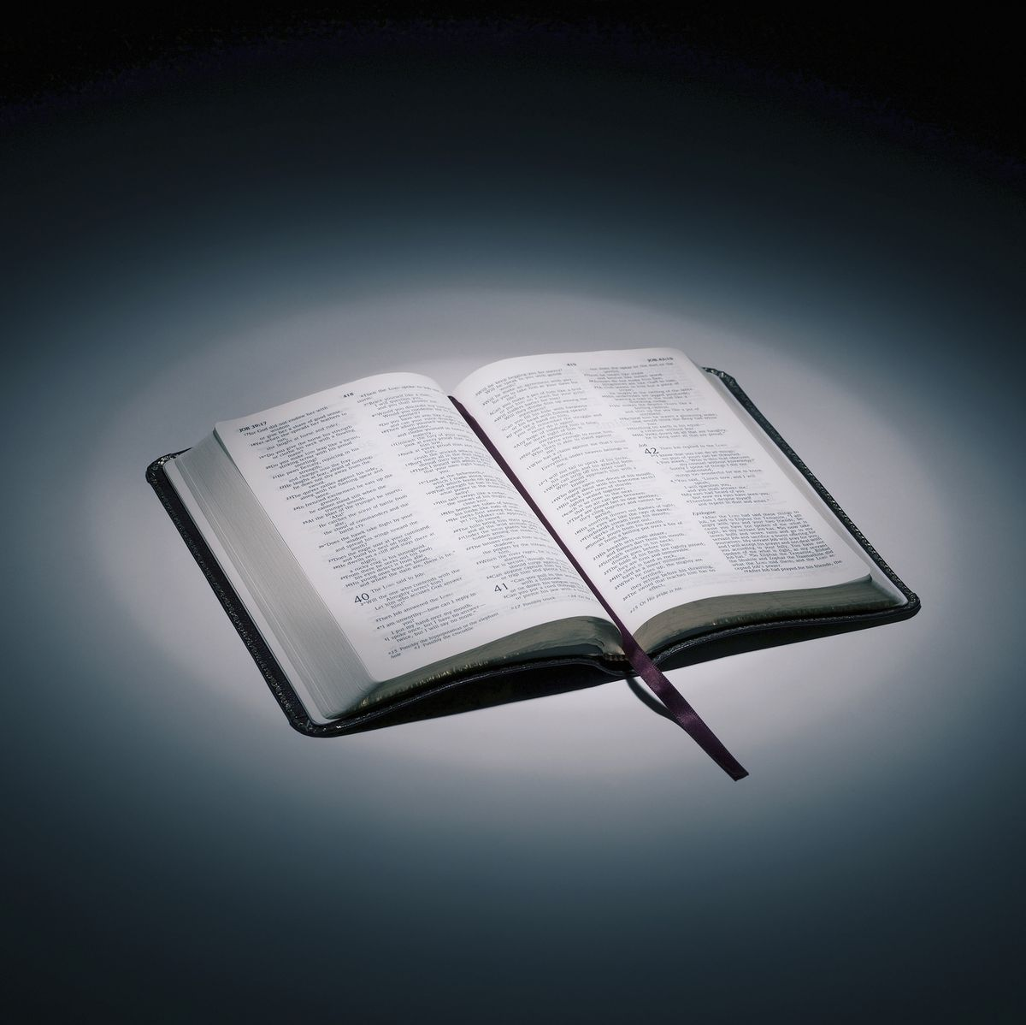
Bible reading

Slide 34
Bible reading: T
T

Slide 35
Announcements

Slide 36





Account name: Blacktown Chinese Christian Church
Account number: 4216 50263
Offering
BSB: 112 - 879
Please put in "offering" as the reference
The offering box is available at the back of the hall

Slide 37
Prayer points

Slide 38
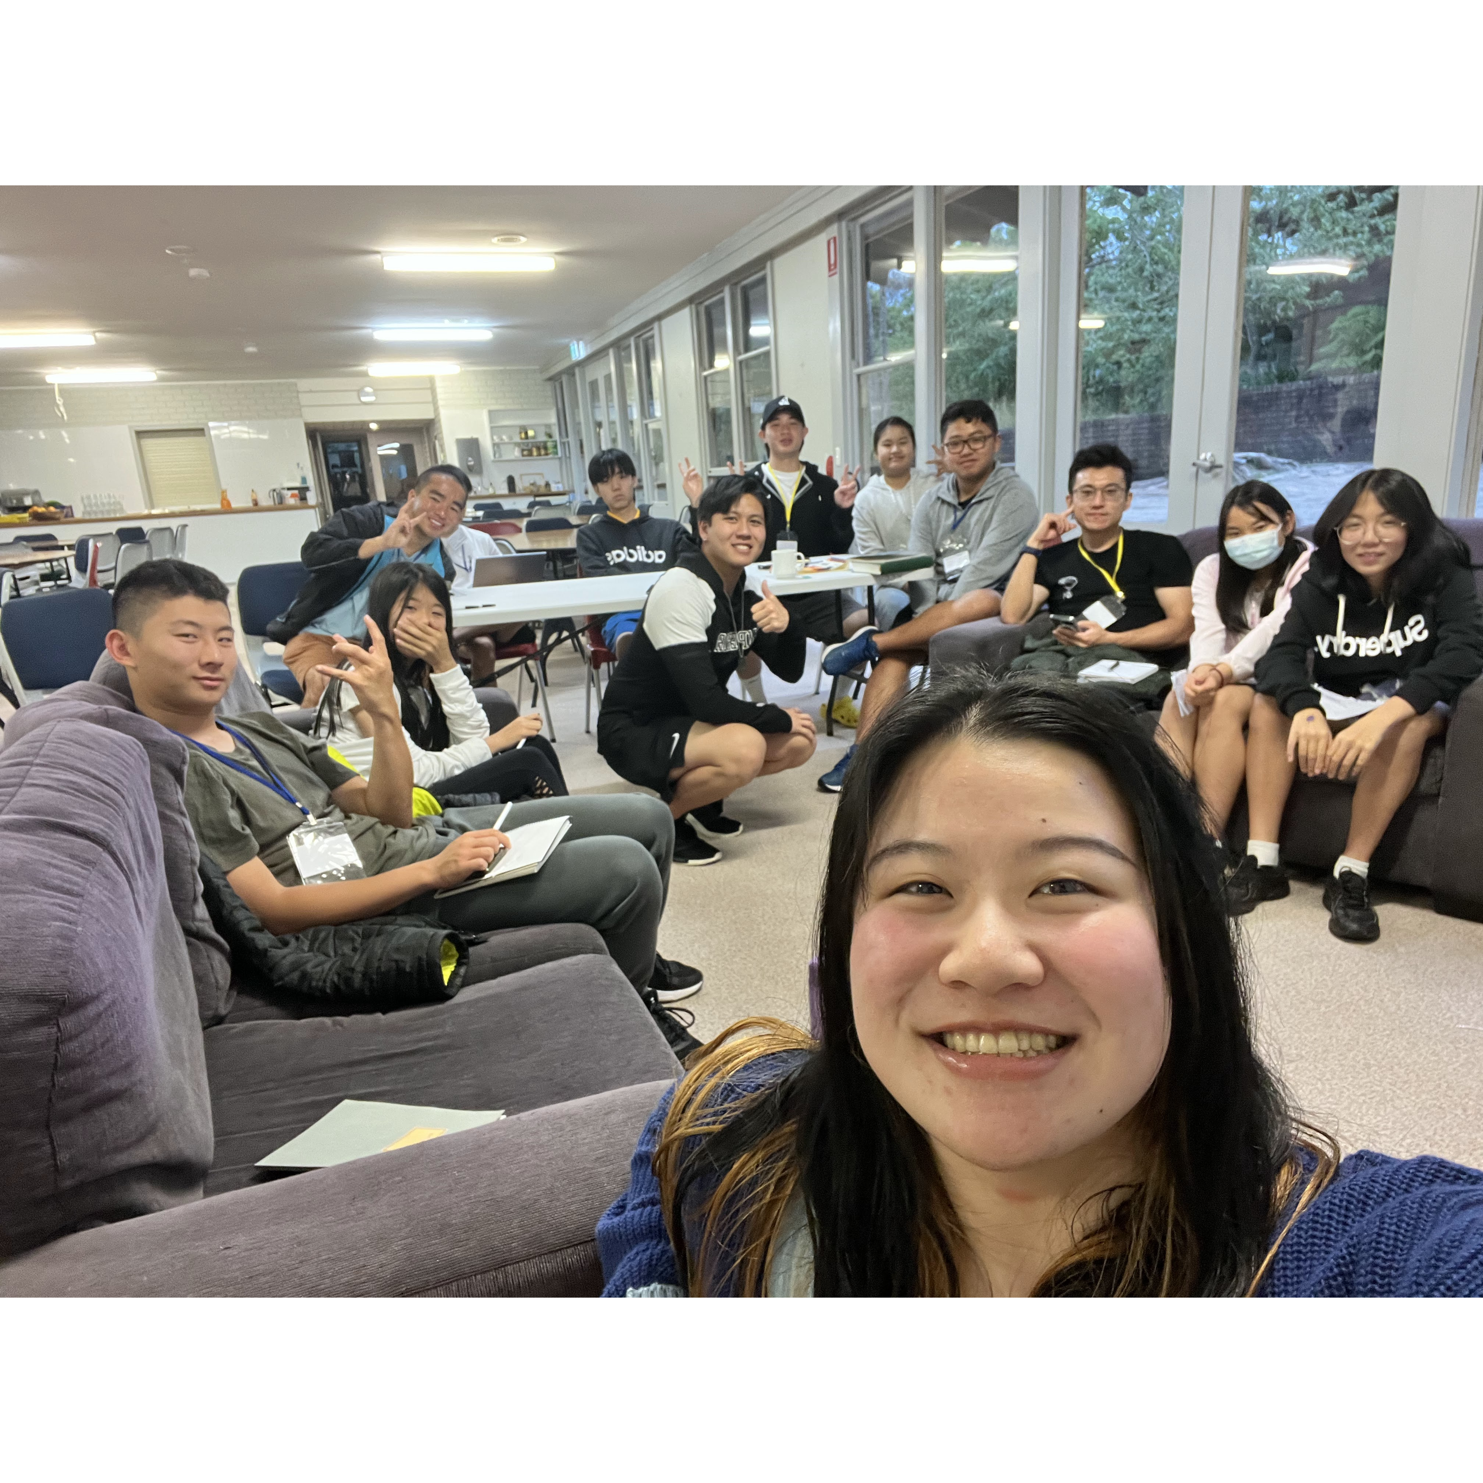
Mingle time!

